Slide 1
DIFFERENTIATION OF
HYPERBOLIC FUNCTIONS

Slide 2
TRANSCENDENTAL FUNCTIONS
Kinds of transcendental functions:
logarithmic and exponential functions
trigonometric and inverse trigonometric functions
hyperbolic and inverse hyperbolic functions
Note:
Each pair of functions above is an inverse to
each other.

Slide 3
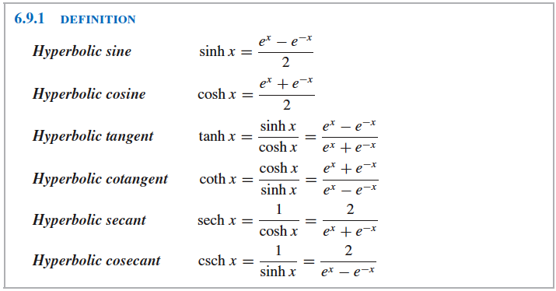

Slide 4
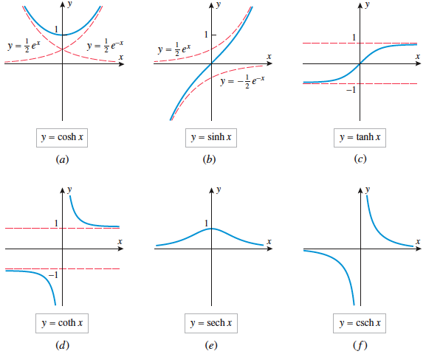

Slide 5
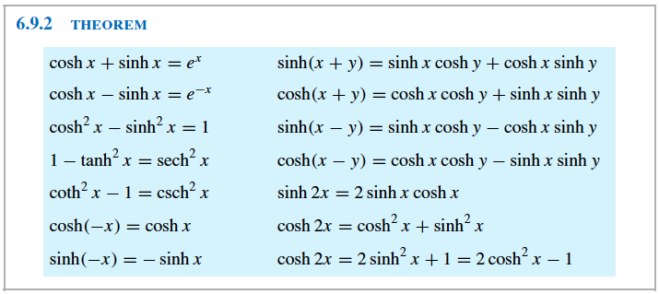
HYPERBOLIC IDENTITIES

Slide 6
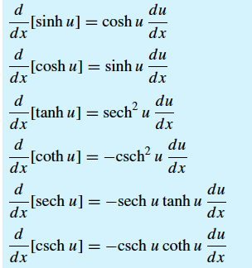
DIFFERENTIATION FORMULA
Derivative of Hyperbolic Function

Slide 7


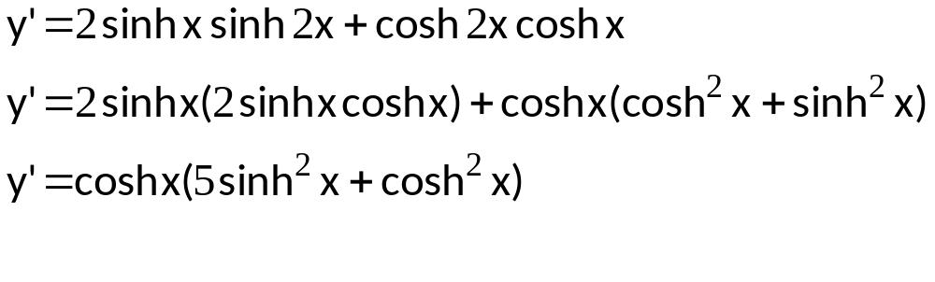
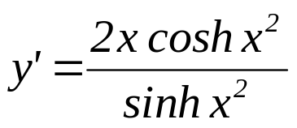









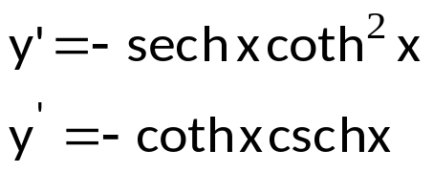

EXAMPLE:
Find the derivative of each of the following functions and simplify the result:

Slide 8


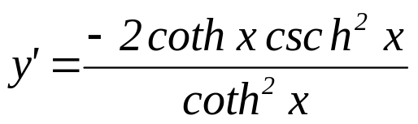
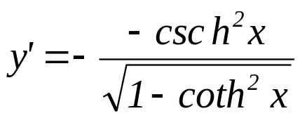
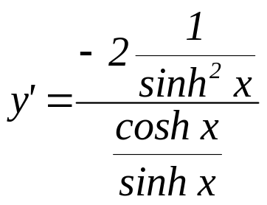
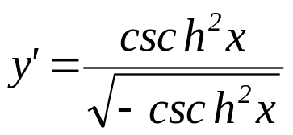
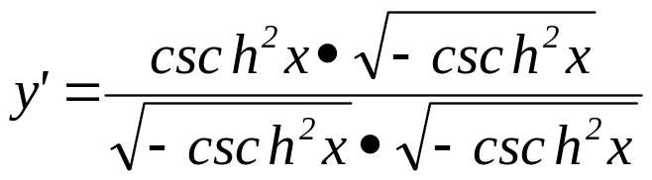
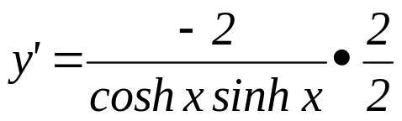
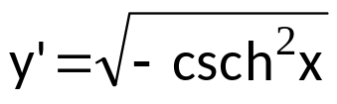
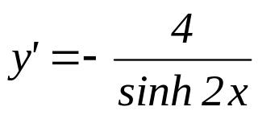


Slide 9

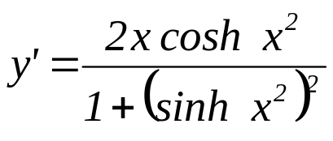
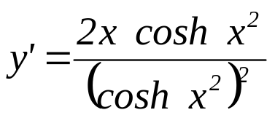


Slide 10
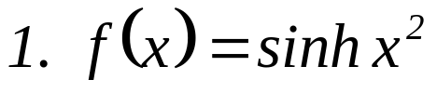

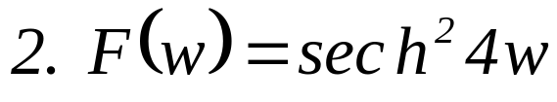

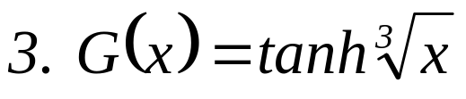

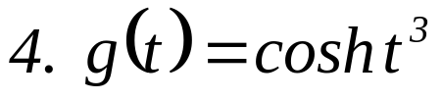
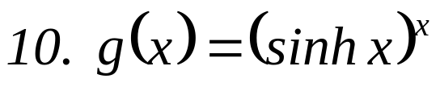
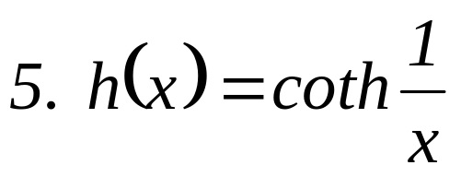


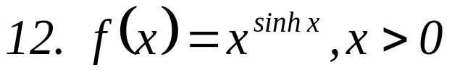
EXERCISES:
A. Find the derivative and simplify the result.

Slide 11



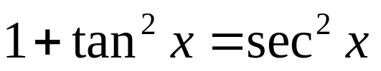

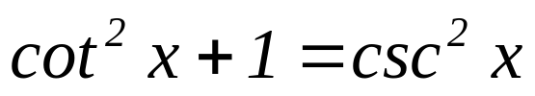
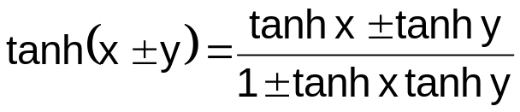
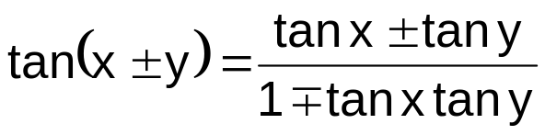
Identities: Hyperbolic Functions vs. Trigonometric Functions
Hyperbolic Functions | Trigonometric Functions

Slide 12




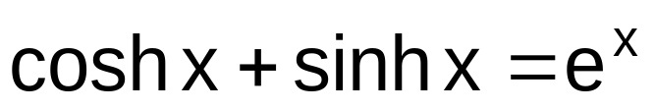
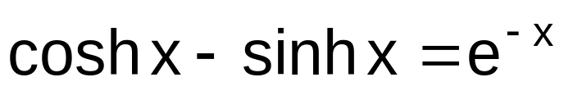
Identities: Hyperbolic Functions vs. Trigonometric Functions
Hyperbolic Functions | Trigonometric Functions
sinh 2x = 2 sinh x cosh x
sin 2x = 2sinx cosx
cosh 2x = cosh²x +sinh²x
cos 2x = cos²x – sin²x

